Slide 1

Binary Search Tree
Kaustubh S Kabra
SE Computers-Shift1
ERP No.34,Teams No.20

Slide 2
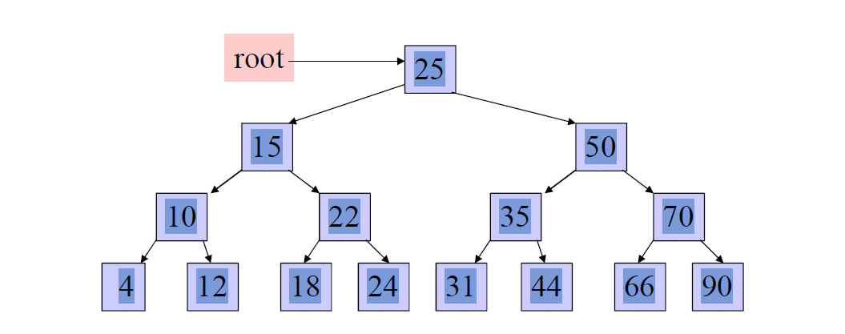
Binary Search Trees (BST)
1. Hierarchical data structure with a single reference to root node
2. Each node has at most two child nodes (a left anda right child)3. Nodes are organized by the Binary Search property:
• Every node is ordered by some key data field(s)
• For every node in the tree, its key is greater than its left child’s key and less than its right child’s key

Slide 3
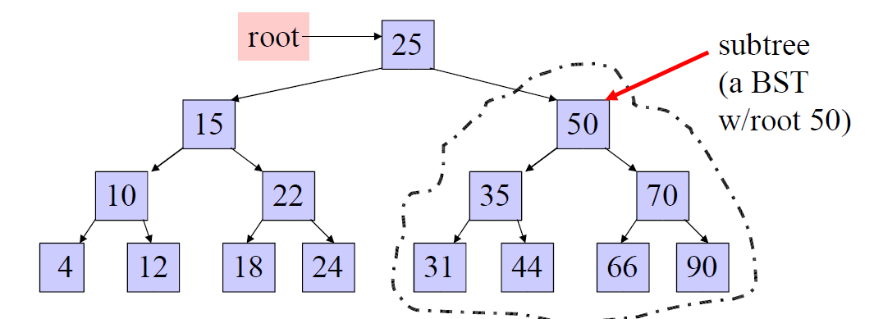
Some BST Terminology
1. The Root node is the top node in the hierarchy.
2. A Child node has exactly one Parent node, a Parent node has at most two child nodes, Sibling nodes share the same Parent node (ex. node 22 is a child of node 15).
3. A Leaf node has no child nodes, an Interior node has at least one child node (ex. 18 is a leaf node).
4. Every node in the BST is a Subtree of the BST rooted at that node.

Slide 4
Implementing Binary Search Trees
Self-referential class is used to build Binary Search Trees
public class BSTNode {
Comparable data;
BSTNode left;
BSTNode right;
public BSTNode(Comparable d) {
data = d; left = right = null;
}
• left refers to the left child
• right refers to the left child
• data field refers to object that implements the Comparable interface, so that data fields can be compared to order nodes in the BST
• Single reference to the root of the BST
• All BST nodes can be accessed through root reference by recursively accessing left or right child nodes

Slide 5
Operations on BST
• Naturally recursive:
– Each node in the BST is itself a BST
• Some Operations:
– Create a BST
– Find node in BST using its key field
– Add a node to the BST
– Traverse the BST visit all the tree nodes in some order

Slide 6
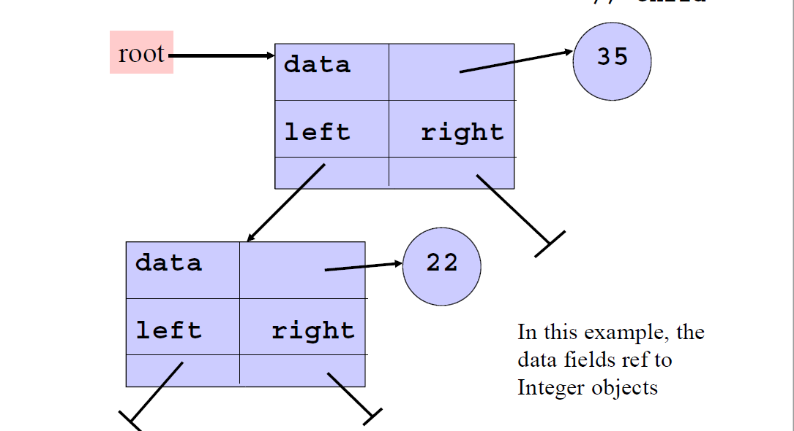
Create a Binary Search Tree
bst_node root = null; // an empty BST
root = new BSTNode(new Integer(35)); // a BST w/1 node
Root.setLeft(new BSTNode(new Integer(22));
// add left// child

Slide 7
Find a Node into the BST
Use the search key to direct a recursive binary search for a matching node
1. Start at the root node as current node
2. If the search key’s value matches the current node’s key then found a match
3. If search key’s value is greater than current node’s
1. If the current node has a right child, search right
2. Else, no matching node in the tree
4. If search key is less than the current node’s
1. If the current node has a left child, search left
2. Else, no matching node in the tree

Slide 8
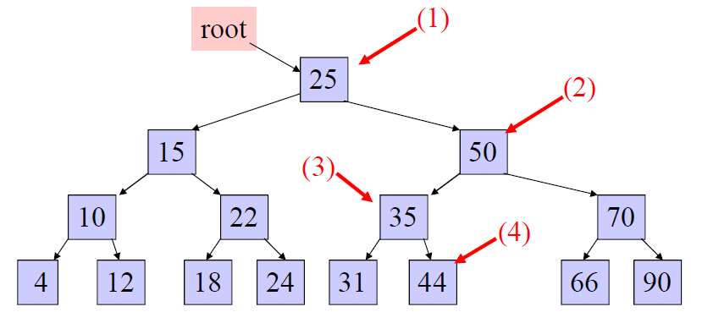
Example: search for 45 in the tree
(key fields are show in node rather than in separate obj ref to by data field):
1. start at the root, 45 is greater than 25, search in right subtree
2. 45 is less than 50, search in 50’s left subtree
3. 45 is greater than 35, search in 35’s right subtree
4. 45 is greater than 44, but 44 has no right subtree so 45 is not in the BST

Slide 9
Insert Node into the BST
1.Always insert new node as leaf node
2. Start at root node as current node
3. If new node’s key < current’s key
1. If current node has a left child, search left
2. Else add new node as current’s left child
4. If new node’s key > current’s key
1. If current node has a right child, search right
2. Else add new node as current’s right child

Slide 10
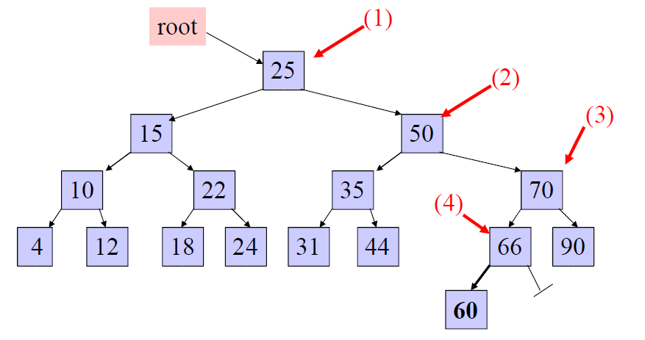
Example: insert 60 in the tree:
1. start at the root, 60 is greater than 25, search in right subtree
2. 60 is greater than 50, search in 50’s right subtree
3. 60 is less than 70, search in 70’s left subtree
4. 60 is less than 66, add 60 as 66’s left child

Slide 11
Traversals
Visit every node in the tree and perform some operation on it (ex) print out the data fields of each node
Three steps to a traversal
1. Visit the current node
2. Traverse its left subtree
3. Traverse its right subtree
The order in which you perform these three steps results in different traversal orders:
– Pre-order traversal: (1) (2) (3)
– In-order traversal: (2) (1) (3)
– Post-order traversal: (2) (3) (1)

Slide 12
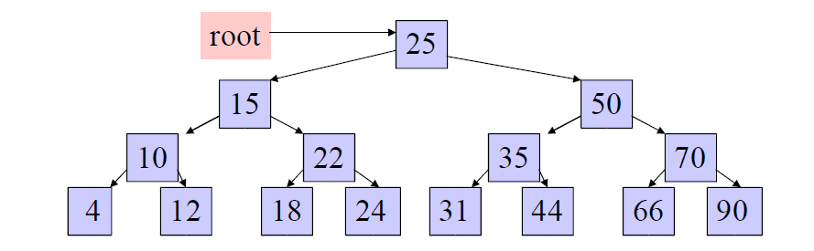
Traversal Examples
In Order(root) visits nodes in the following order:
4, 10, 12, 15, 18, 22, 24, 25, 31, 35, 44, 50, 66, 70, 90
A Pre-order traversal visits nodes in the following order:
25, 15, 10, 4, 12, 22, 18, 24, 50, 35, 31, 44, 70, 66, 90
A Post-order traversal visits nodes in the following order:
4, 12, 10, 18, 24, 22, 15, 31, 44, 35, 66, 90, 70, 50, 25

